Slide 1
SEC555
Presentation based on SEC555: SIEM with Tactical Analytics
Detecting Modern PowerShell Attacks with SIEM
Justin Henderson (GSE # 108) @SecurityMapper

Slide 2

About Us
Author of SEC555: SIEM with Tactical Analytics
GIAC GSE # 108, Cyber Guardian Blue and Red
58 industry certifications (need to get a new hobby)
Two time NetWars Core tournament winner (offense)
And security hobbyist and community supporter
Collecting interns/contributors in bulk (research teams)
Release research to the community
See https://github.com/SMAPPER

Slide 3
Welcome!
A copy of this talk is available at: https://github.com/HASecuritySolutions/presentations
More free stuff: https://github.com/HASecuritySolutions Special Thanks:
Thank you to Lee Holmes and the Microsoft PowerShell team for their research and pure awesomeness!

Slide 4

PowerShell Awesomeness
PowerShell is one of the BEST things that ever happened
For both defense and offense
It is an equal opportunity employer
Defenders
Automate everything (firewalls, IDS, etc.)
Administration, Auditing, Hunt teaming, and much more
Attackers
Completely own you and bypass controls

Slide 5
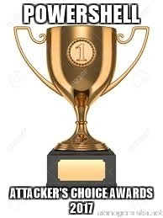

PowerShell = Attacker's Choice Award
Attackers/malware love PowerShell, but why?
On lots of systems with multiple versions
Almost always enabled and allowed
Whitelisting - Allowed
Antivirus - Allowed
NextGen whatever / EDR - Allowed
Can be enabled remotely even if currently disabled
Lots of pre-built attacks available using PowerShell

Slide 6

Sample of PowerShell Evilness
Common attack tools and frameworks available:
PowerSploit - Collection of evil modules and goodies
PowerShell Empire - Post-exploitation agent framework
Nishang - Useful all around pentesting framework
Invoke-Mimikatz - Memory based version of Mimikatz
Attack Devices
Rubber Ducky - Keyboard emulation
Bash Bunny - Pure evilness with a cute bunny

Slide 7

Disabling PowerShell
If PowerShell is so evil why not just disable it?
You need it… You really, truly need it
Automation is key tool in a defenders toolbelt
The good can/should outweigh the bad
In a world without PowerShell…
Attackers would simply pick a different attack vector
Your defense capabilities would be weak

Slide 8
PowerShell Prevention
Talk is primarily around detection rather than prevention
Specifically using logs and a SIEM (super powerful)
Worth mentioning some PowerShell security mechanisms
ExecutionPolicy - Not really a security feature
Just Enough Administration (JEA) - Controls who can do what with PowerShell
Constrained Language Mode - Limits certain functionality often used by malware (non-core features)

Slide 9
Catching PowerShell Evil
Ideally you want to catch PowerShell attacks… at scale
For this we need SIEM + log sources
Key PowerShell data sources
Module logging
Script Block logging
Transcription logging
Process creation events
Sysinternals Sysmon logs
PowerShell specific
Command line logging

Slide 10
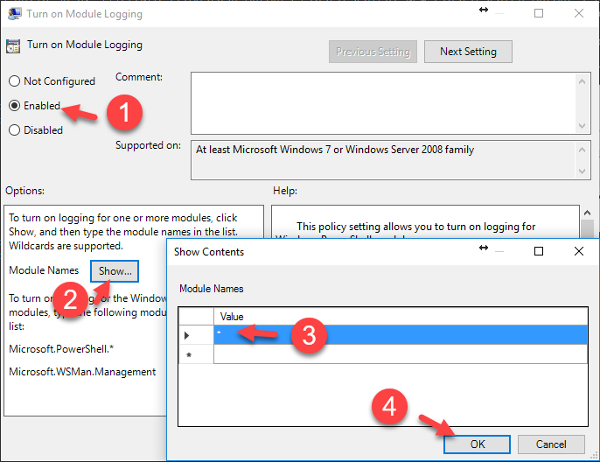
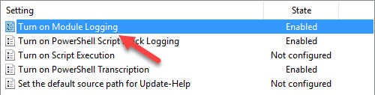
Module Logging
Enables Event ID 4103
Records module use
And parameters
Very verbose…

Slide 11
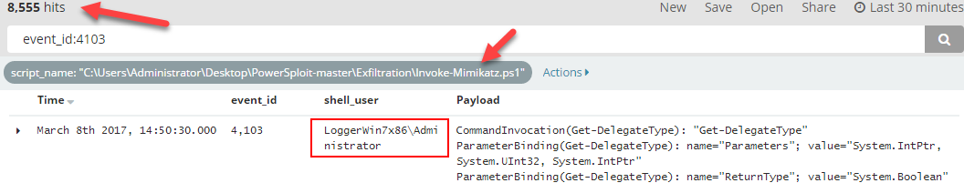
Module Logging Example
Invoke-Mimikatz.ps1 ran on Windows 7 box with PS v5.1
8,555 events logged from running script once
Includes functions and parameters called
Logs based on every time a module is used

Slide 12
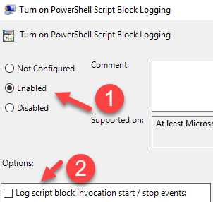
Script Block Logging
PowerShell v5 added Script Block Logging (Event ID 4104)
Records blocks as they are executed
If too large spans multiple events
Data is decoded in log
Event type of WARNING used to log suspicious commands
WARNING events enabled by default
Can log start/stop times (4105, 4106)

Slide 13
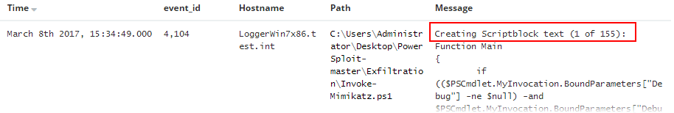
Script Block Logging Example
Invoke-Mimikatz.ps1 on same system = 509 events
Volume is a bit more easy to handle
But still a lot of data
Includes what is executed only
Does not log output

Slide 14
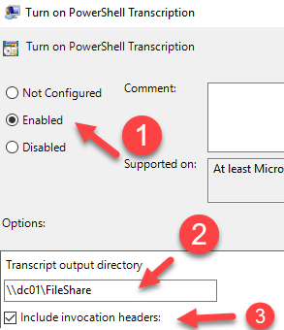

Transcription Logging
Also introduced in v5 was transcription logging
Contains both input and output
Saves to a file
Default: “My Documents\yyyyMMdd”
Location can be changed to centralized location

Slide 15
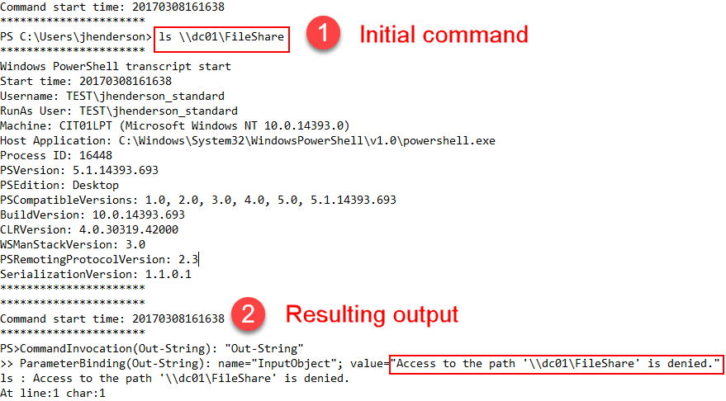
Transcription Example

Slide 16
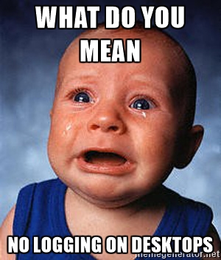
Endpoint Logging
Today, client-side attacks are more common
Means the attack occurs at the desktop
Which means you need desktop logs…
Yet, cost of desktop logs is considered too high
If strategy is collect everything, that is true
If strategy is to stay nimble and tactical, it is more expensive not to log…
Advanced agent filtering is helpful or file server tricks

Slide 17
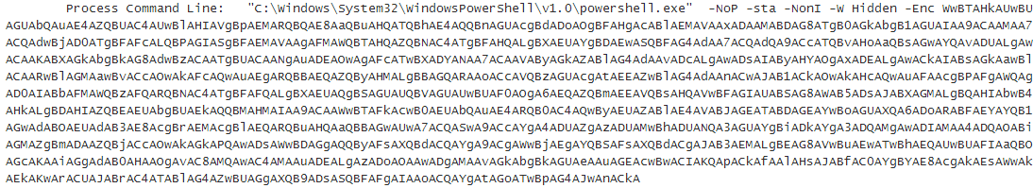
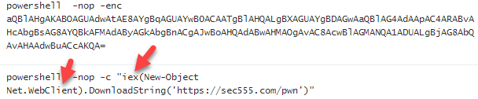
PowerShell Command Line (Event ID: 4688)
PowerShell is now commonly used for modern attacks

Slide 18
Command Line
Adversaries like to bypass script files due to AV detection
Thus long, obfuscated commands are common
Or calls to download and execute code are made
Another example of their strength = their weakness
Key augmentations for discovery:
Command line length (> 500 is odd)
Base64 discovery
Execution of downloaded code

Slide 19
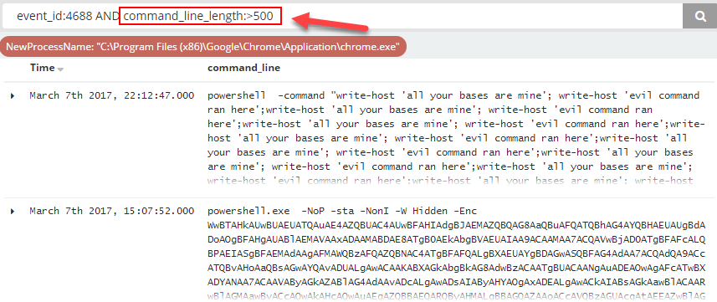
Command Line Length

Slide 20
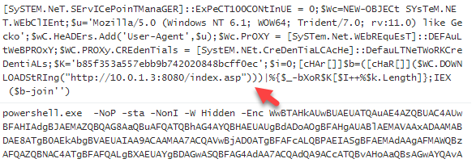
Base64 Encoding
Common to see base64 encoded PowerShell attacks
Can be extracted using regex and then decoded
Example: (?<base64_code>[A-Za-z0-9+/]{50,}[=]{0,2})

Slide 21
Download and Execute
Code can be downloaded and run to minimize length
Also works with base64 encoding
Invoke-Expression (iex) runs commands passed to it
Net.WebClient acts as a PowerShell web browser

Slide 22
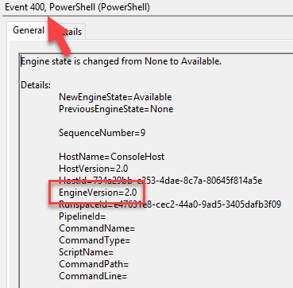
PowerShell Downgrade Attacks
PowerShell v5 awesome security features
Bad guys do not like v5
But v5 systems have v2 - v5
Downgrade attacks bypass security
Except Event ID 400 gives it away
Look for EngineVersion less than 5

Slide 23

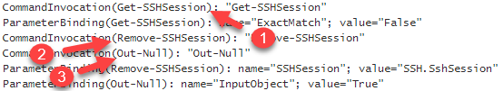
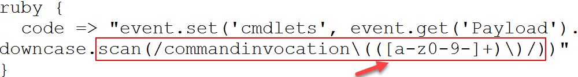
PowerShell Command Monitoring
JEA requires modifications and process changes
Alternative solution is to parse and monitor commands from module logging
Group regex match can extract all commands to an array
Parses into

Slide 24
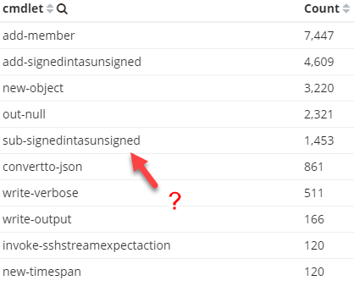
PowerShell Whitelist Detection
Alternative method can be used to export all cmdlets
Export from trusted systems
Use as whitelist of cmdlets
Then alert on anything new
Can be expanded to include
Parameters
Users
Systems

Slide 25
PowerShell Without PowerShell
PowerShell does not equal PowerShell.exe
It can be loaded using DLLs
System.Management.Automation.Dll
System.Management.Automation.ni.Dll
System.Reflection.Dll
Catching requires monitoring DLL load events
Such as with Sysmon Event ID 7 or commercial software

Slide 26
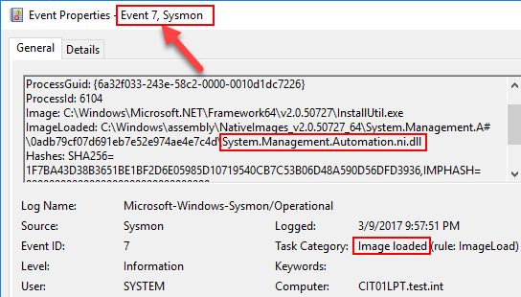
Sysmon PowerShell Example

Slide 27
Summary
PowerShell is awesome yet scary
Learn it, know about it, and detect unauthorized use
Simple detects can find a lot
Look for long command line lengths
Look for encoding
Check cmdlets against whitelist == Totally awesome
Look for downgrade attempts
Look for PowerShell use outside powershell.exe

